Slide 1
System for Tracking Animals using Radars
STAR
Sangam ’22
Energy and Environment
NIT Trichy

Slide 2
TEAM
MEMBERS
Madhav R
111120083
B.Tech in Mechanical Engineering
Rishivanthiya G R
110119092
B.Tech in ICE
K Girish
108119053
B.Tech in ECE
Sunkara Vikash
107120124
B.Tech in EEE

Slide 3
CONTENTS
A discussion on the current methods on the monitoring of animals in Wildlife reserves/sanctuaries and zoos
Introduction to contactless methods using radars
FMCW
Methodology of STAR
Hardware used and features
Use of MATLAB

Slide 4
PROBLEM STATEMENT
Extinction of over 18 species of wild animals in the last century
Despite efforts taken through wildlife reserves and sanctuaries, poaching remains to be a threat
Locating and monitoring the movement and vitals of the animals in reserves are challenging

Slide 5
CURRENT METHODS
Existing methods involve use of cameras, which prove to be disadvantageous because of their limited field of vision and range, and poor performance in harsh weather conditions.
While microchip implants that use may help track the different animals of the same species, it cannot actively locate or track the vitals of said animals.
GPS devices are also not the best option as they are susceptible to damage and are sometimes too large to be implanted into animals.

Slide 6
OBJECTIVES OF STAR
The main objectives of this project are to:
Detect and measure vital signs of animals.
Tracking both animal and human movements to prevent poaching and hunting in wildlife sanctuaries.
This will be accomplished using FMCW Radar.

Slide 7
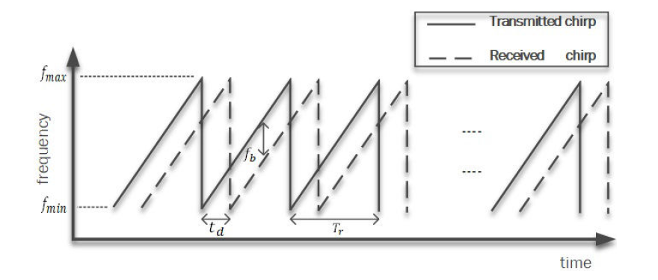
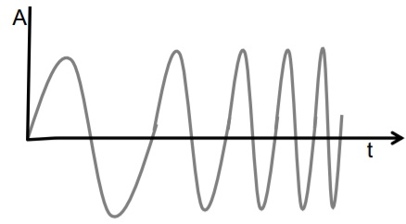

FMCW RADARS

Slide 8
FLOWCHART

Slide 9
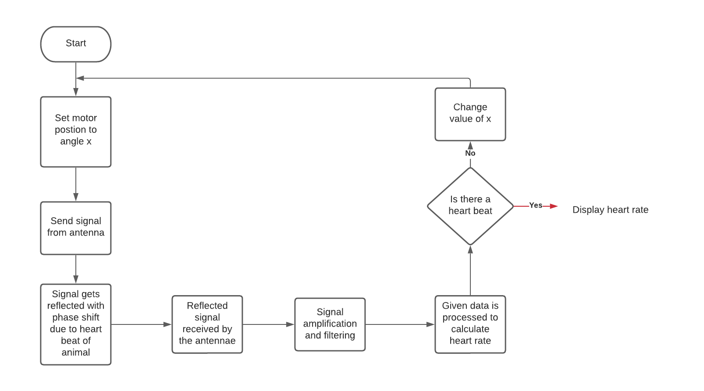
FLOWCHART

Slide 10
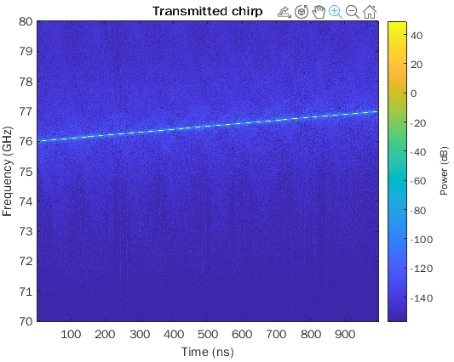
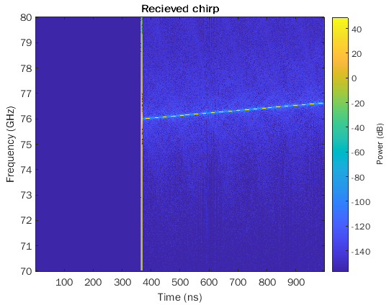
SIMULATION

Slide 11
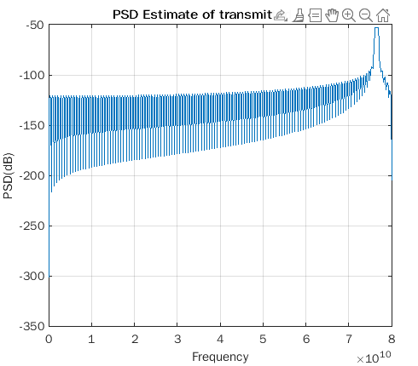
SIMULATION

Slide 12
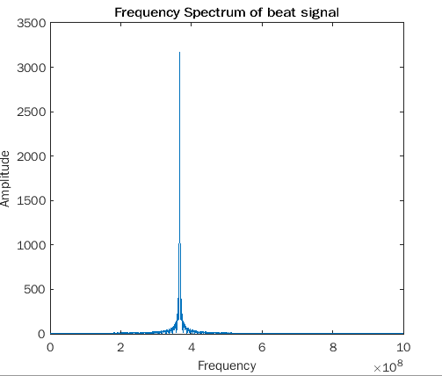
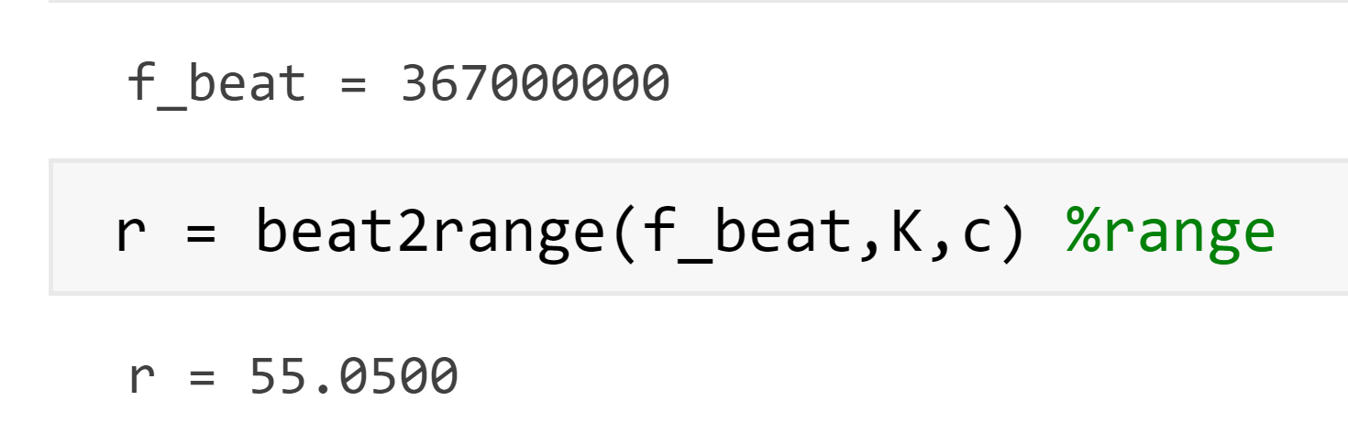

Slide 13
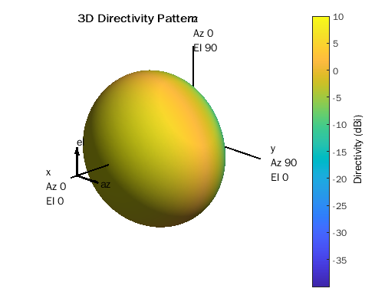
SIMULATION - Antenna Radiation Pattern

Slide 14
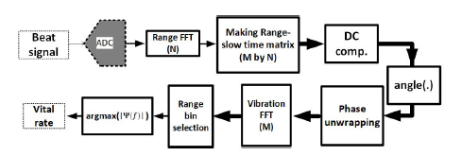
PROPOSED ALGORITHM FOR DETECTING VITAL SIGNS

Slide 15
Simulation - Further Plans
Implement Velocity Estimation for a single target.
Implement Range and Velocity estimation for multiple targets.
Model Respiration and heartbeat along with environmental noise and detect the same using the proposed algorithm.

Slide 16
HARDWARE
1. Radar Sensor Chip - AWR1843
2. Antenna
3. CAN-FD transceiver-TCAN1042HGVDRQ1
4. XDS110 based JTAG emulation with a serial port-(TM4C1294NCPDT)

Slide 17
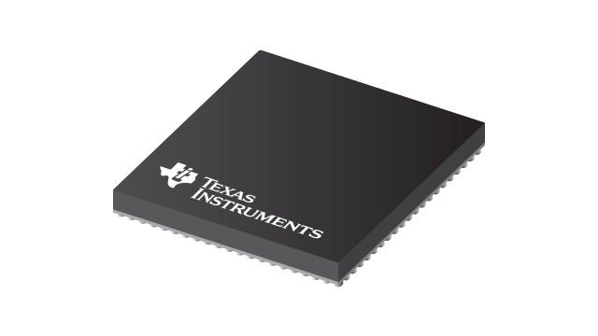
Radar Sensor Chip - AWR1843
mmWave radar sensor - 76-81GHz
Single-chip, Low-power – Achieved through RFCMOS technology
Integrated processing – Removes the need for an external processor in the system
Scalable Portfolio – SW re-use across Automotive & Industrial platforms, regardless of band
Imaging Radar – Lidar-like performance at the right price point

Slide 18
SCHEMATIC

Slide 19
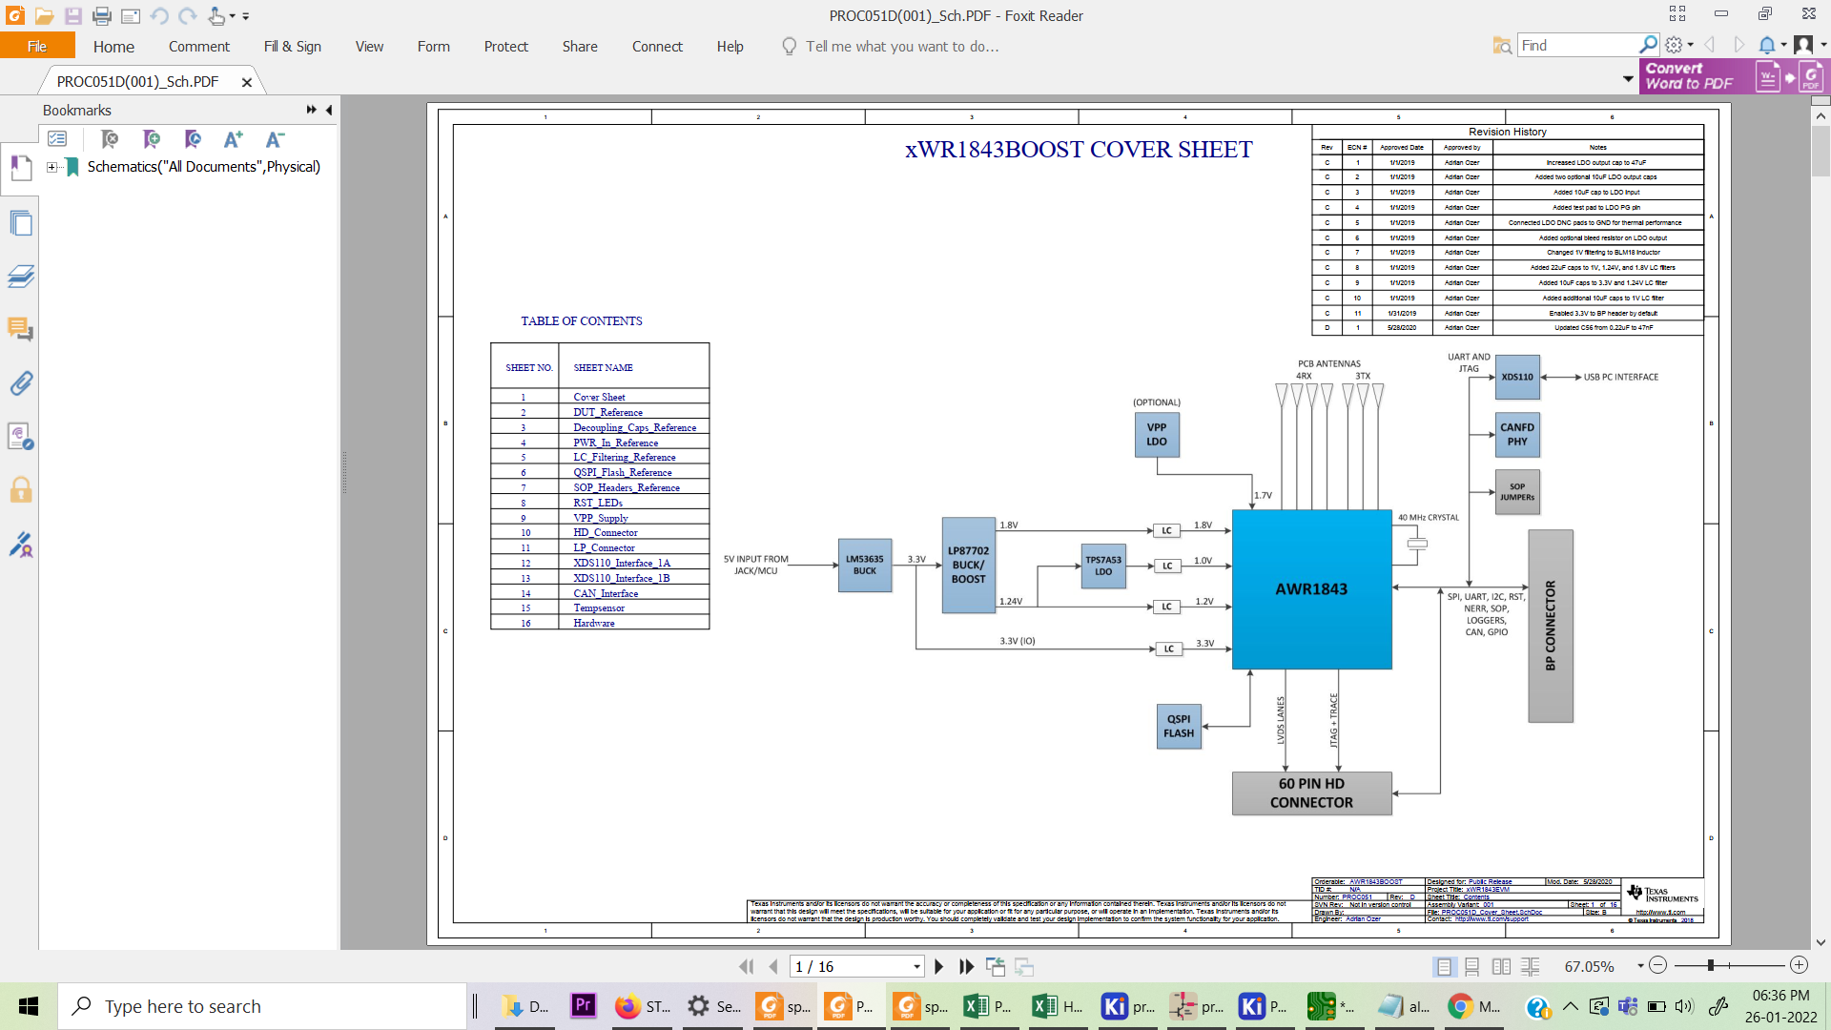
SCHEMATIC

Slide 20
ESTIMATED COST
Fabrication Components
(material, joints,etc. ) - INR 2500
Radar Sensor Chip + PCB +
Components - INR 20,000
Power supply - INR 1500
Estimated Cost - INR 24,000

Slide 21
WHAT’S NEXT?
Solid platform on MATLAB for testing the proposed algorithm.
Testing the hardware using humans for detecting vital signs.
This project can also be extended to multiple other applications

